Slide 1
What is Android?
Android is a Linux based operating system it is designed primarily for touch screen mobile devices such as smart phones and tablet computers. It is the stack of software's those communicate together to perform a specific task. One of the most widely used mobile OS these days is android. The Android Inc was founded in Palo Alto of California in 2003 by Andy Rubin, Rich miner, Nick sears and Chris White.
The hardware that supports android software is based on ARM architecture platform. The android is an open source operating system means that it’s free and any one can use it. The first version 1.0 of android development kit (SDK) was released in 2008
Later Android Inc. was acquired by Google in 2005. After original release there have been number of updates in the original version of Android. It comes under Open Handset Alliance

Slide 2
Advantages of Android
Android is Linux based open source operating system , it can be developed by any one
Easy access to the android apps by Google Play or direct APK distribution.
You can replace the battery and mass storage, disk drive and UDB option
Its supports all Google services including Google I/O
The operating system is able to inform you of a new SMS and Emails or latest updates using broadcast receiver.
It supports Multitasking, more then one application can work together
Android phone can also function as a router to share internet like HotSpot
Its free to customize and redistribution
Can install a modified ROM.
Its supports 2D and 3D graphics for gaming and good visual impact.

Slide 3
What is Activities?
An application that has a visible UI is implemented with an activity. When a user selects an application from the home screen or application launcher, an activity is started.

Slide 4
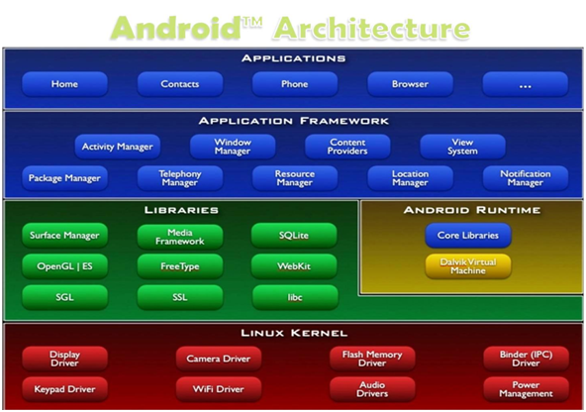
Android Architecture
divided into five sections and four main layers

Slide 5
Linux kernel
The android uses the powerful Linux kernel which is written C and it supports wide range of hardware drivers. The kernel is the heart of the operating system that manages input and output requests from software. This provides basic system functionalities like process management, memory management, device management like camera, keypad, display etc the kernel handles all the things. The Linux is really good at networking and it is not necessary to interface it to the peripheral hardware. The kernel itself does not interact directly with the user but rather interacts with the shell and other programs as well as with the hard ware devices on the system.

Slide 6
Libraries
The on top of a Linux kennel there is a set of libraries including open source web browser such as webkit, library libc. These libraries are used to play and record audio and video. The SQLite is a data base which is useful for storage and sharing of application data. The SSL libraries are responsible for internet security etc.

Slide 7
Android Runtime
The android runtime provides a key component called Dalvik Virtual Machine which is a kind of java virtual machine. It is specially designed and optimized for android. The Dalvik VM is the process virtual machine in the android operating system. It is a software that runs apps on android devices.
The Dalvik VM makes use of Linux core features like memory management and multithreading which is in a java language. The Dalvik VM enables every android application to run it own process. The Dalvik VM executes the files in the .dex format.

Slide 8
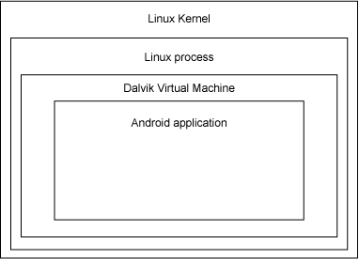
Application architecture
As mentioned, Android runs atop a Linux kernel. Android applications are written in the Java programming language, and they run within a virtual machine (VM). It's important to note that the VM is not a JVM as you might expect, but is the Dalvik Virtual Machine, an open source technology. Each Android application runs within an instance of the Dalvik VM, which in turn resides within a Linux-kernel managed process.

Slide 9
Services
A service should be used for any application that needs to persist for a long time, such as a network monitor or update-checking application

Slide 10
Content providers
A content provider's job is to manage access to persisted data, such as a SQLite database. If your application is very simple, you might not necessarily create a content provider. If you're building a larger application, or one that makes data available to multiple activities or applications, a content provider is the means of accessing your data

Slide 11
Broadcast receivers
An Android application may be launched to process a element of data or respond to an event, such as the receipt of a text message
An Android application, along with a file called AndroidManifest.xml, is deployed to a device. AndroidManifest.xml contains the necessary configuration information to properly install it to the device. It includes the required class names and types of events the application is able to process, and the required permissions the application needs to run. For example, if an application requires access to the network — to download a file, for example — this permission must be explicitly stated in the manifest file. Many applications may have this specific permission enabled. Such declarative security helps reduce the likelihood that a rogue application can cause damage on your device.

Slide 12
Virtual reality
At Google I/O on May 2016, Google announced Daydream, a virtual reality platform that relies on a smartphone and provides VR capabilities through a virtual reality headset and controller designed by Google itself.^{[98]} The platform is built into Android starting with Android Nougat, differentiating from standalone support for VR capabilities. The software is available for developers, and was released in 2016

Slide 13
Hardware
Android is the ARM (ARMv7 and ARMv8-A architectures), with x86, MIPS and MIPS64, and x86-64 architectures also officially supported in later versions of Android. The unofficial Android-x86 project provided support for the x86 architectures ahead of the official support. MIPS architecture was also supported before Google did. Since 2012, Android devices with Intel processors began to appear, including phones and tablets. While gaming support for 64-bit platforms, Android was first made to run on 64-bit x86 and then on ARM64. Since Android 5.0 "Lollipop", 64-bit variants of all platforms are supported in addition to the 32-bit variants. minimum amount of RAM for devices running Android 7.1 range from in practice 2 GB for best hardware, down to 1 GB for the most common screen, to absolute minimum 512 MB for lowest spec 32-bit smartphone.

Slide 14
Version | Code Name | Date of Release | API Level | Usage
1.0 | Alpha | Sep 2008 | 1 | 0.00%
1.1 | Beta | Feb 2009 | 2 | 0.00%
1.5 | Cupcake | April 2009 | 3 | 0.05%
1.6 | Donut | Sep 2009 | 4 | 0.00%
2.0-2.1 | Eclair | Oct 2009 | 5-7 | 1.00%
2.2- 2.2.3 | Froyo | May 2010 | 8 | 2.00%
2.3-2.3.7 | Gingerbread | Dec 2010 | 9-10 | 5.00%
3.0-3.2.6 | Honeycomb | Feb 2011 | 11-13 | 6.00%
4.0-4.04 | Ice Cream Sandwich | Oct 2011 | 14-15 | 7.00%
4.1-4.3.1 | Jelly Bean | July 2012 | 16-18 | 7.60%

Slide 15
Supported Versions
Version | Code Name | Date of Release | API Level | Usage
4.4 – 4.4.4 | KitKat | Oct 2013 | 19-20 | 16.00%
5.0 – 5.1.1 | Lollipop | Nov 2014 | 21-22 | 30.00%
6.0 – 6.0.1 | Marshmallow | Oct 2015 | 23 | 32.00%
7.0 – 7.1.2 | Nougat | Aug 2016 | 24-25 | 17.00%
8.0 | Oreo | Aug 2017 | 26 | 0.20%

Slide 16
What is new in Oreo
Project Treble, the biggest change to the foundations of Android to date: a modular architecture that makes it easier and faster for hardware makers to deliver Android updates
Picture-in-picture support
Support for Unicode 10.0 emoji (5.0) and replacement of all blob-shaped emojis by round ones with gradient and outline
Restructured Settings by regrouping in sections similar entries
Notification improvements like Notification channels, Notification dots (badges) ,Notification snoozing, Coloured backgrounds for notifications
Android Go option, an optional lightweight distribution of Android for low-end devices with less than 1GB RAM (Oreo 8.0 or higher)
App-specific unknown sources
Multi-display support
2 times faster boot time
Apps background execution and location limits
Google Play Protect
Downloadable fonts
Integrated printing support
Deep color (Wider color gamut for apps)
Wi-Fi Assistant

Slide 17
Android Emulator
The emulator is a new prototype that is used to develop and test android applications without using any physical device.
The android emulator has all of the hardware and software features like mobile device except phone calls. It provides a variety of navigation and control keys.
It also provides a screen to display your application. The emulators utilize the android virtual device configurations. Once your application is running on it, it can use services of the android platform to help other applications, access the network, play audio, video, store and retrieve the data

Slide 18
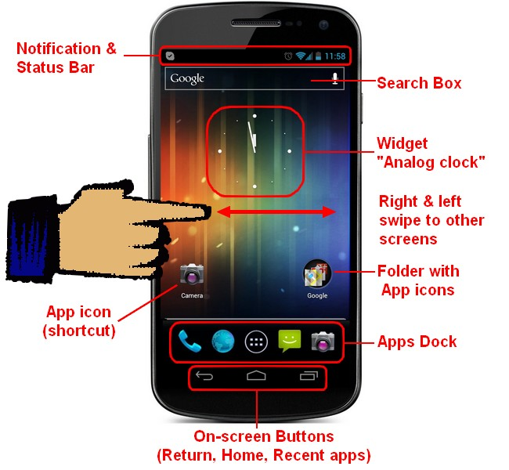
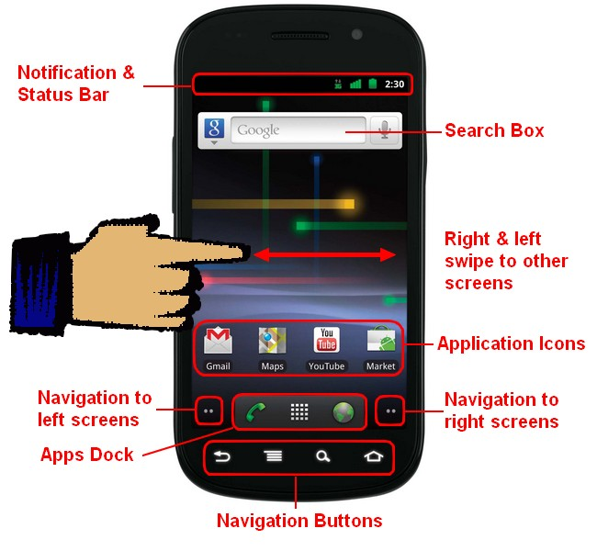

Slide 19
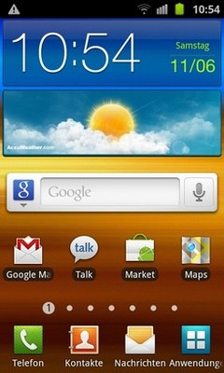
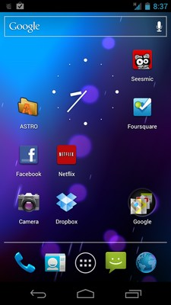
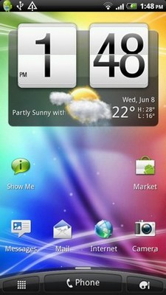

Slide 20
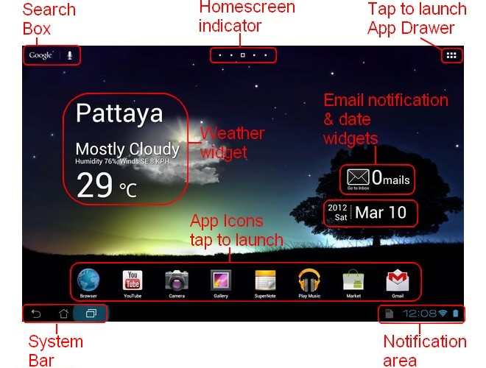

Slide 21
System Requirements for Android Development?
Microsoft® Windows® 7/8/10 (32- or 64-bit) or Linux or Mac
4 GB RAM minimum, 8 GB RAM recommended; plus 1 GB for the Android Emulator
3 GB of available disk space minimum, 6 GB Recommended (500 MB for IDE + 2.5 GB for Android SDK and emulator system image)
For accelerated emulator: Intel® processor with support for Intel® VT-x, Intel® EM64T (Intel® 64), and Execute Disable (XD) Bit functionality
Android Studio or Eclipse, NetBeans or any other Java IDE
Android SDK (Free available)
Java (JDK 1.8)

Slide 22

Why Android Studio
Android Studio uses Gradle Build system. Which is quite faster than Eclipse’s and NetBeans Apache Ant
Android Studio’s Autocomplete feature quite better than other IDE
Designing UI has always been complex but Android Studio has completely changed this .The new interface design too in Android Studio is faster, responds to changes more rapidly and has more customization options that with other IDE.
JetBrains' IntelliJ IDEA launched Android Studio in May 2013.
ProGuard integration and app-signing capabilities.
Built-in support for Google Cloud Platform, enabling integration with Firebase Cloud Messaging (Earlier 'Google Cloud Messaging') and Google App Engine

Slide 23
Why Android SDK
Required libraries
Debugger
An emulator
Relevant documentation for the Android application program interfaces (APIs)
Sample source code
Tutorials for the Android

